Slide 1
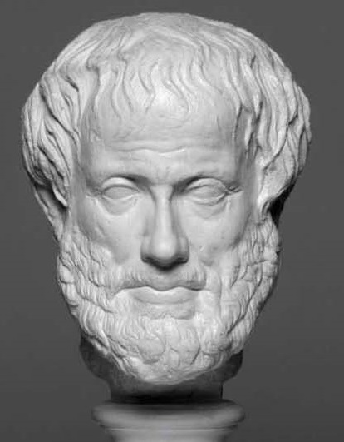
Backbone of the Swiss Financial Center goes DevOps
Robert Scherrer, DevOps Enterprise Summit, 5 June 2017
Notes:
Backbone of the Swiss Financial Center – not exactly what you would expect as driver for change in IT?

Slide 2
“There is no great genius without some touch of madness”
Aristotle (384 - 322 b.c.)

Slide 3
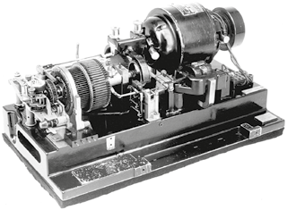


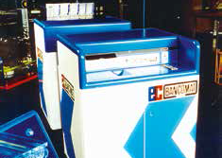

1930
Stock Exchange Ticker
1961
Stock Exchange TV
1975
Investdata Terminal Clients directly access largest securities database in the world
1983
Swiss Interbank Clearing Realtime Gross Settlement of all interbank Swiss franc transactions
SIX – Pioneer spirit since 1930
1985
Bancomat 85/ec Direct
Fully electronic card processing on ATM and petrol stations
1995
Electronic trading
First exchange in the world with electronic trading along the entire value chain
2010
Terravis
Electronic land registry
Notes:
If you look at a bank, it was founded as a bank and not as an tech company.
Even Amazon was founded as an online bookshop.
SIX was founded as a tech company. Already in the beginning, it’s objective was to provide technology to financial institutions.
We used the latest technology available, be it telegraph, tv broadcast, online terminals, satellite uplinks. Whatever was available, we used it to the benefit of our customers.
In the last forty years, we switched more and more to straight-through-processing. We have still the only securities facility where a trade is finally settled on the security as well as the cash side seconds after matching.

Slide 4
SIX - For a stable and efficient financial market infrastructure
1930 the company was founded to provide a stock exchange ticker.
4000 people
working for SIX in 36 locations in 25 countries.
587 billion francs flow backwards and forwards in interbank payments each day.
24 million
financial instruments are covered in the SIX data universe.
< 20 microseconds
Roundtrip time for orders at the stock exchange.
700 engineers and operators
are providing the software applications to run the business of SIX.
Notes:
We are the Swiss Stock Exchange, an international CSD,
we process payments in many European countries
and provide comprehensive data about financial products on a global scale.
And I am extremely proud that we are only 700 to build and run the software for these four businesses.

Slide 5
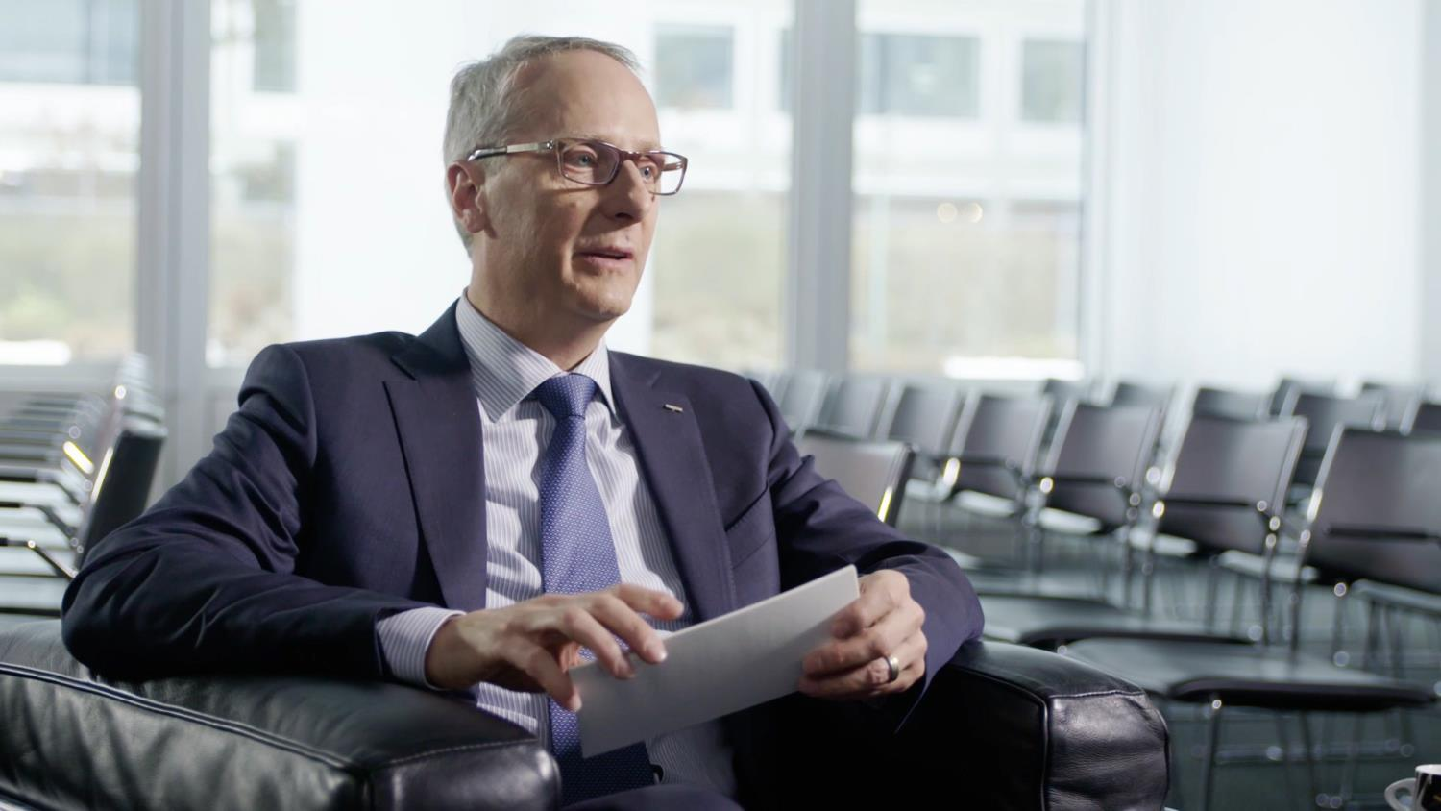

“Our organisation needs to be able to adapt and move much faster.
We need to reduce lead times across the board, cutting the time between having the initial idea to market launch.”
Dr. Urs Rüegsegger, Group CEO
Notes:
Our continuous success is our legacy.
To stay competitive in the digitalized world, we need to adapt much faster to the market needs. And this is exactly the message from our CEO.
But: Cutting lead times across the board? Isn’t this a bit ambitious?

Slide 6

“Hope is the dream of a waking man”
Aristotle (384 - 322 b.c.)
Notes:
It is definitely not easy to change an old and process oriented company into something agile and flexible, but at least there was hope.

Slide 7

We started with a core team of pioneers to build a new culture
Bild: Alessio Bragadini from Milan, Italy - Haka, CC BY-SA 2.0, https://commons.wikimedia.org/w/index.php?curid=14840436
Notes:
Me and my friend as the heads of Dev and Ops in our company, we started the DevOps movement with a small core team.
We started during the 2015 rugby world cup and we were impressed by the performance of the All Blacks and how they demonstrate determination and team spirit with their Haka before their games.
So we have chosen the moto of the Haka for our DevOps movement, wear black polos and show the same spirit.

Slide 8





The 5+1 dimensions of DevOps at SIX
mindset is crucial
stay out of the way
Skills
Organisation
Specialist
Functional teams
Specialised Generalist
X-functional teams
existing systems in scope
find origin – then adapt
Architecture
Process
Mindset &
Attitude
Monolithic/Packaged
Manual Hand-offs
Services/APIs
Infrastructure
Continuous Delivery
Manual Provisioning
the fun part
Automated Provisioning
Notes:
From the beginning, it was clear that it is about people and mindset and attitude.
We have to tackle tools and technology, which is the most easy part.
We have to adapt architecture, but we decided to cover the existing software too and not only try DevOps on a fancy new Web Portal.
It gets definitely harder when it comes to changing processes, as you often cannot find out where they come from and why they are as they are.
For the organization, we wanted to change the mode of working first and only later change the organization in way that it stays of the way of delivery.
Last but not least, we have to build up skills, but this is not possible without people having the right mindset and attitude.

Slide 9
“Educating the mind without educating the heart is no education at all.”
Aristotle (384 - 322 b.c.)
Notes:
As Aristotle already told us that we have to teach the heart too.
Now how do we touch the heart?
For sure not with nicely designed E-Learning-Lessons!
You remember what Aristotle said about madness? We were mad enough to decide to bring the core team on stage and perform a theatre play in front of hundreds of employees.

Slide 10
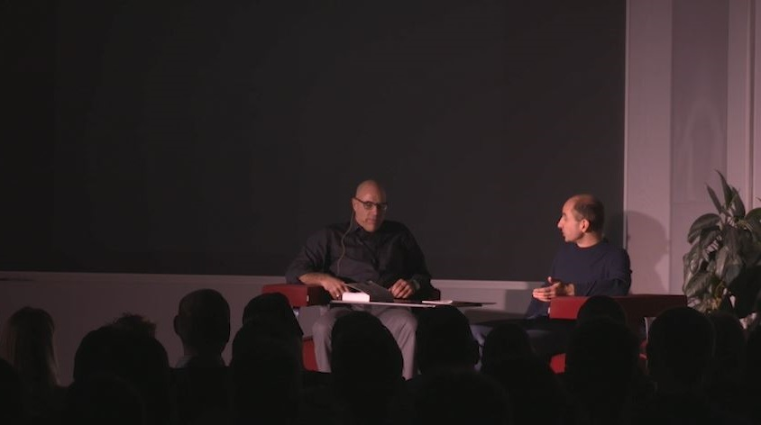
DevOps theatre performance on stage
Notes:
So lights went on, and starting with the heads of Dev and Ops arguing about who is right and who is wrong…

Slide 11
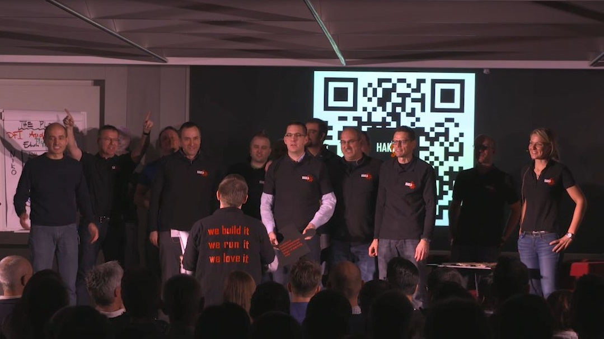
DevOps theatre performance on stage
Notes:
…and ended up transporting the spirit as a core team with one voice
And believe me, the company talked about DevOps for days and weeks after that.
We continue to use the on stage approach and present our achievements every few weeks in front of audience and we have more audience than ordinary status reports have readers.

Slide 12
“We are what we repeatedly do. Excellence then, is not an act, but a habit”
Aristotle (384 - 322 b.c.)
Notes:
So the spirits were raised, but Aristotle teaches us to find excellence in repetition.
Think of the huge success of the All Blacks. They wouldn’t have won the second title in a row without daily training. No sports professional would go to the most important tournament of the year without daily training. But that is exactly how IT professionals install their yearly releases.

Slide 13


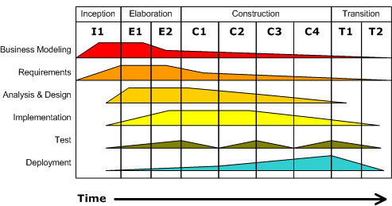
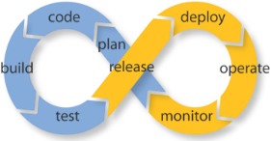
What you do continuously, you do excellently
Process
Requirements
Design
Implementation
Verification
go towards continuous processes
Maintenance
Notes:
So we go to continuous mode, because if we do test and deployments repeatedly and fully automated, we will get excellent in it.
What we actually did was choosing a product and a project and then we sponsored them to automate releases, streamline processes, use container technology and so on.
At the same time, we triggered internal competition. Each and every team can win a Haka award for DevOps achievements, a widely visible flag that they can mark their workplace. With this little trick, we had Docker containers in production before our sponsored projects did. DevOps adoption was converted into a race.
I remember when our system engineer supplied a base image for Docker essentially for one team. A few weeks later, he showed me the Kibana dashboard where the counter of Linux servers running Docker exceeded the number of 80. The race was on!

Slide 14


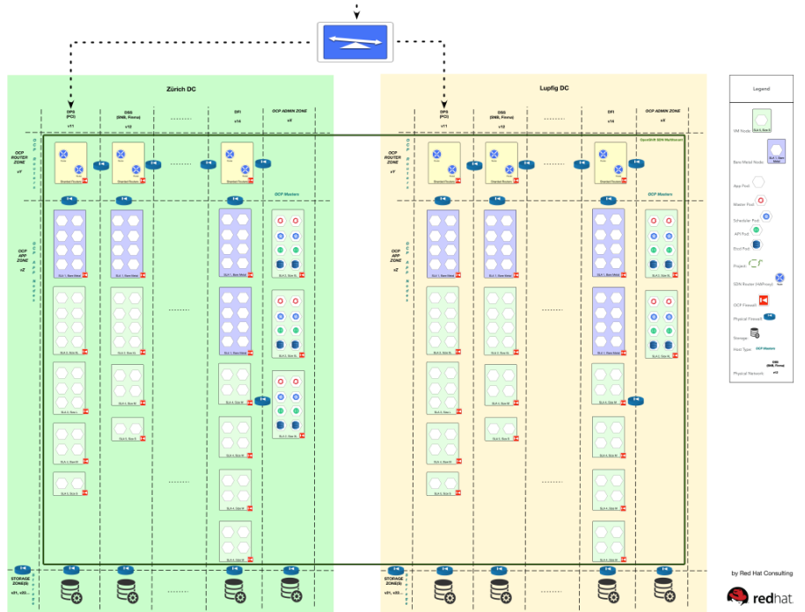




We are building scalable infrastructure
Infrastructure
Immutable containers
Automated scaling
Software Defined Network
and
Allows to restrict applications to specialized hardware for high performance computing environments
Notes:
In the technology stream, we increase test and release automation and with replacing heavy weight installations with container deployments.
In the mean time, we have set up a scalable container management platform and start migrating existing applications to it.

Slide 15

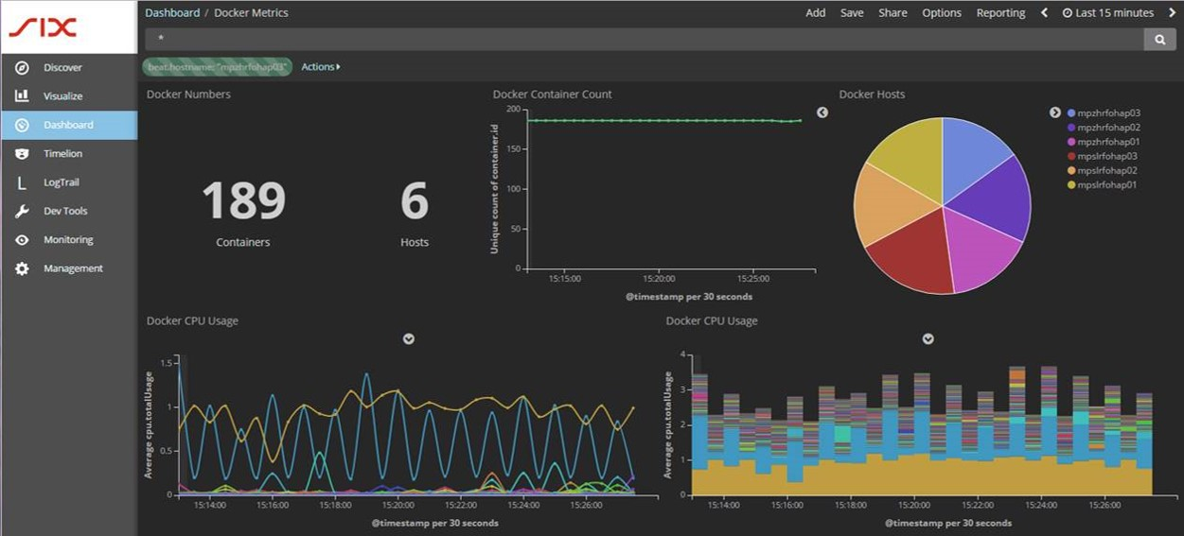
Old business on new technology: first ATM traffic on containers with automated test and deployment
Architecture
Notes:
Migrating applications sometimes only means reshuffling of components, sometimes it means re-architecturing whole systems and migration from heavy-weight platforms to linux.
For more than thirty years, our payment business scaled on Tandem computers, now the new generation of our ATM network relies on container management of smaller services.

Slide 16
“You will never do anything in this world without courage”
Aristotle (384 - 322 b.c.)
Notes:
With all this technology stuff, we reach the limits of our current organisation and its control framework. We needed some courage to go a step further and break these limits.

Slide 17
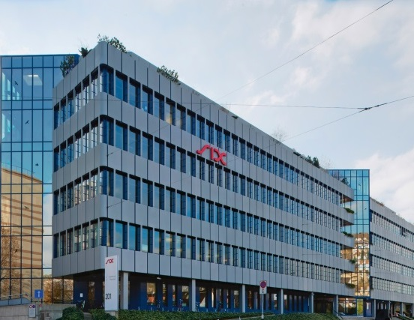






Stakeholder management with audit, compliance, risk and security officers is essential
Notes:
As our company is in financial business in many countries, we have to comply to requirements and standards of multiple organizations.
So there is always a good reason not to change a process or not to dare a new approach.
It’s not that DevOps makes the situation worse. In the contrary, I am absolutely convinced that we bring more transparency, more security and better auditability. But that does not help if we cannot convince our compliance officers and auditors that have a stake in the sustainable success of the company. So we have to work with them to achieve what we want to achieve.
And very often, the external standards give you freedom to act, but the internal interpretation restricts the way forward. So we had to amend the existing security framework. And for sure you need some courage to do this, but first and foremost, we needed a good relationship to the responsible persons

Slide 18



Where we came from: silos prevent x-functional teams
Organisation
Global IT Organisation
Architecture & Project Management
Requirements Engineering & Solution Design
Application Engineering
IT Operation
Notes:
We need also courage to tear down the walls between the silos of our organisation.
In our organisation, the people needed for building a DevOps cluster were organized in different silos, with separate line managers, conflicting goals and a lot of process definitions restricting collaboration.

Slide 19
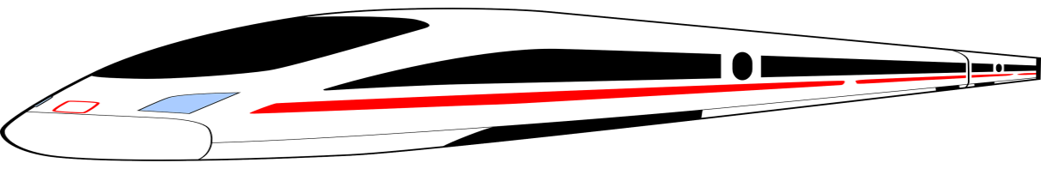
Starting the change: DevOps clusters deliver faster
Organisation
Global IT Organisation
Architecture & Project Management
Requirements Engineering & Solution Design
Application Engineering
IT Operation
Notes:
So we started building one first DevOps cluster across departments, moved the people together in one office space and involved business representatives from the beginning.
We consciously started where we have the highest number of functional changes per year and the least regulated business. So we could expect the best business value and less hurdles.
The results were encouraging in the sense of raw speed as well as feedback from business.
About half a year later, we defined more clusters in the same business line, and this year, we are scaling to the next two business areas.

Slide 20
Transform the organisation: Value Streams
Organisation
Global IT Organization
Delivery Pipe Payments
Delivery Pipe Financial Information
Architecture & Project Management
Requirements Engineering & Solution Design
Application Engineering
IT Operation
Infrastructure & Security
Delivery Pipe Security Services
Delivery Pipe Stock Exchange
Notes:
By end of this year, we will get rid of the remainders of the silo organization and have a pure value stream oriented setup at least for the IT of our company.
An organizational form that stays out of the way for delivery of software.
We see the reorganization of IT as a start to something bigger. In first business lines, we already have the business and IT in one room collaborating closely, and this is the way I envision for the future of our business.

Slide 21


From I- to T- to π-shaped profiles
Skills
Generalist
Generalist
Specialist
Novice
Specialist
Specialist
I’m great at this one thing.
I’m great at this one thing and familiar with all this other stuff.
I’m great at this one thing, learning a new area and familiar with all this other stuff.
You’ll find open minded people for π-shaped jobs and strong collaboration inside your company.
Reward this behavior, promote the pioneers – and culture will follow.
Notes:
Now a new org chart doesn't help if the employees mentally stay in their silo.
I am fully aware that we need the highly skilled specialists for our high-tech solutions, embedded in x-functional teams. But not only!
The question was, where to find the flexible ones?
We found them amongst us:
older employees that used to work that way a long time ago and never fully understood why they weren’t allowed to work that way anymore
young employees that have not yet been trained to stick to one role
holistically thinking renegades that never accepted close boundaries and now have the room to perform
<Question to audience about culture>
So we made sure that we reward this behavior openly to make clear which culture we support.
But is this enough to shorten lead times?

Slide 22
“What lies in our power to do, it lies in our power not to do”
Aristotle (384 - 322 b.c.)

Slide 23
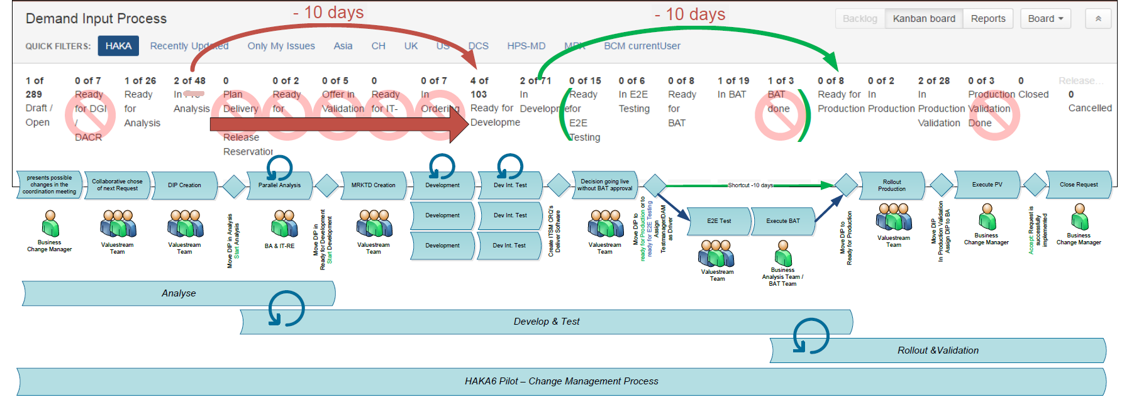
The easiest way to save time and money is to skip unnecessary process steps
Process
Notes:
The easiest way to save time and money is to skip unnecessary process steps…
… and there are many of them in grown enterprises
Do you have an estimation process for every software you write?
<Walter-Anecdote>

Slide 24
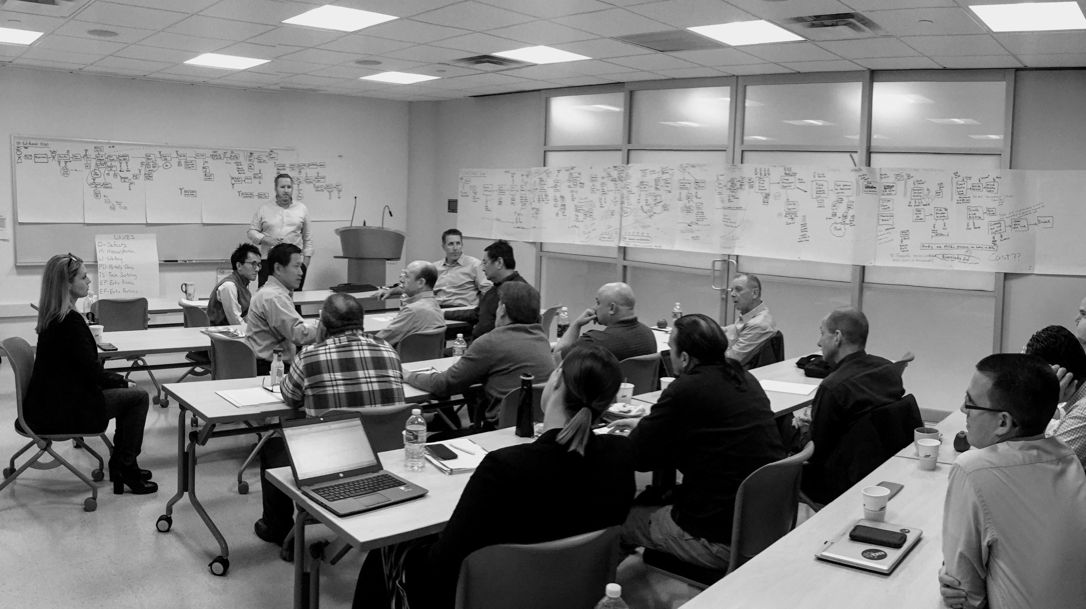

We won’t stop until we don’t do anything anymore that we don’t have to
Focus on small improvement stories and
discipline in bringing continuous improvement up and running
Notes:
When you have skipped what you can skip, it is time to go back to basic lean management techniques.
We started analyzing how the work is done, to optimize downstream flow and to remove waste wherever we can. As an example of last week, we could take out four weeks out of a major release plan and give the customers more time for testing at the same time. A thing we couldn’t have achieved without business and IT in one room and value stream mapping techniques.

Slide 25



We are on a successful DevOps journey
We have developers and operators sharing ops responsibility and on-call duty on all applications
We have already hundreds of servers running containers
We have more and more applications using a CI/CD pipeline
We transform the former silo organisation into value streams

Slide 26
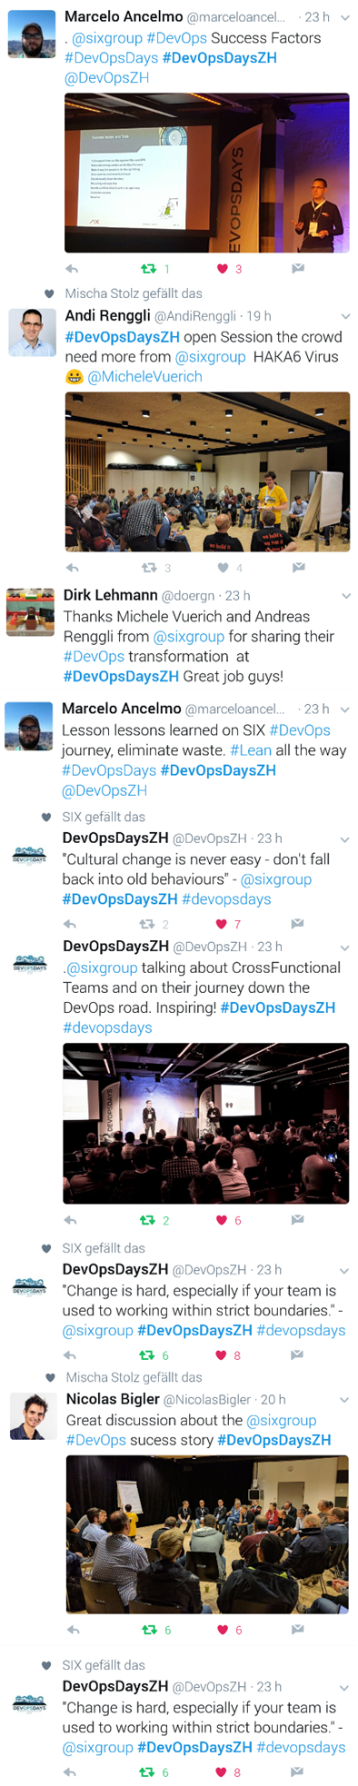
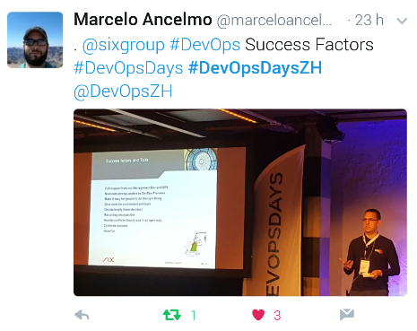
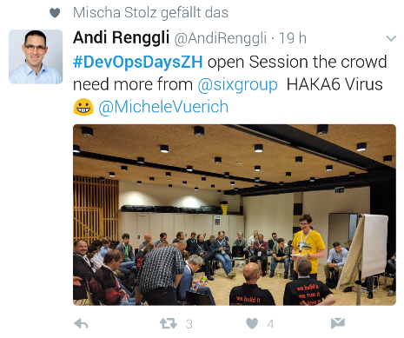
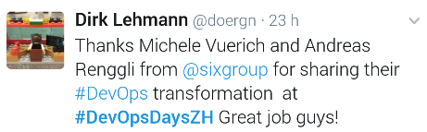
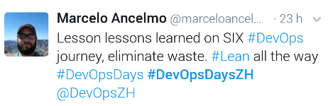
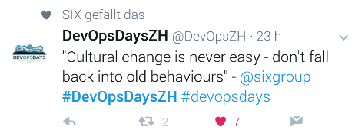
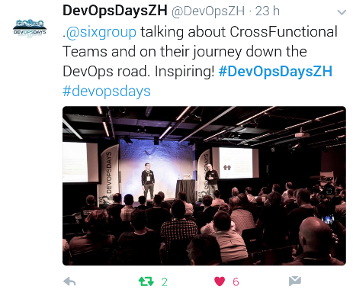
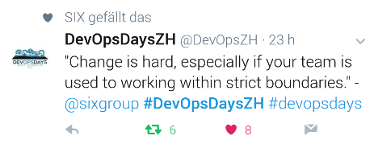
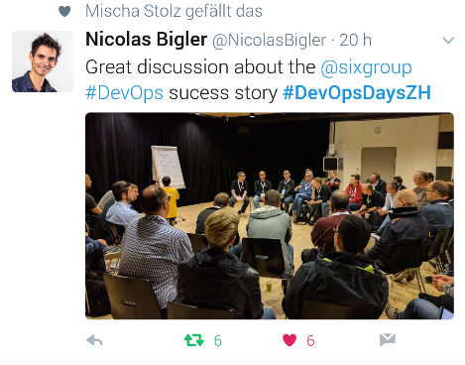
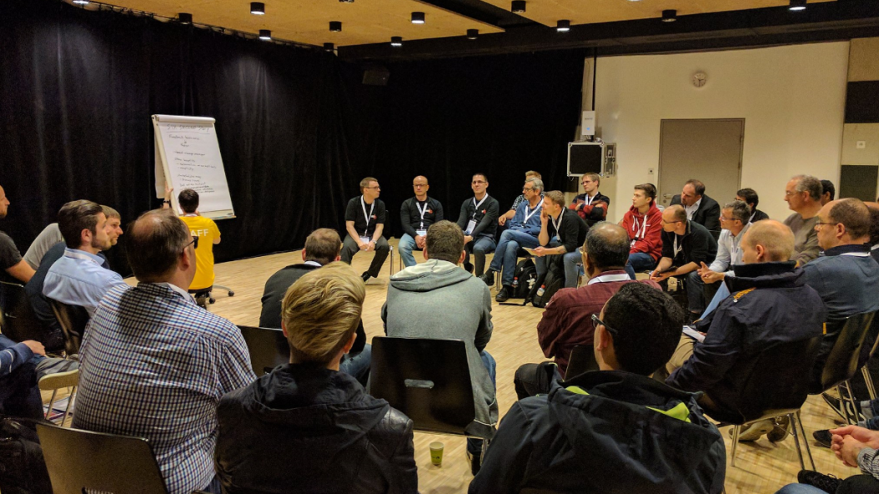

Swiss DevOps community hanging on the lips of the SIX pioneers
Notes:
SIX is leading the DevOps community in Switzerland

Slide 27

and
Our aim was never only to try it out on a web portal…
…our aim was always to transform the company

